Slide 1
Project Review (Final VIVA)
Presentation

Slide 2
CHAT-BOT USING NATURAL LANGUAGE PROCESSING (NLP) IMPLEMENTED IN CLOUD TECHNOLOGY
Mohamed Irfan.M (E19CSR064)
Wasim Jaffer.A (E19CSR125)
Basil Ahamed.H (E19CSL302)
Project Supervisor
(Sugumaran.V.R.,M.Tech)
1904CS851 Project Work

Slide 3
Abstract
The chatbot developed in this project is built using advanced NLP techniques such as sentiment analysis, entity recognition, and intent detection. These techniques allow the chatbot to understand the context of user queries and provide accurate responses.
The chatbot is trained using a large corpus of data, which enables it to learn from user interactions and improve its responses over time. The implementation of the chatbot in cloud technology provides several advantages such as scalability, flexibility, and cost-effectiveness.
The chatbot can handle a large volume of user queries and can dynamically scale up or down based on demand. The cloud-based platform also provides easy integration with other cloud-based services such as analytics, database, and machine learning. The chatbot can be used in various domains such as customer support, e-commerce, healthcare, and education.
It can provide users with personalized recommendations, answers to frequently asked questions, and assistance with tasks such as booking appointments or ordering productS

Slide 4
Base Paper Details
Title of the Paper:
A Conversation-Driven Approach for Chat-bot Management
Journal Name:
IEEE Xplore
Publication date:
January 24, 2022
Author’s Name:
Guilherme Guy de Andrade

Slide 5
Literature Review
S NO: | TITLE | AUTHOR AND YEAR | PROBLEM IDENTIFIED
1. | A Review of Chat-bot Applications for Education: Opportunities and Challenges | Name: Alvin W. Yeo and Dongfang Liu Year: 2022 | Limited understanding of the potential applications of chat-bots in education and the challenges associated with their development and implementation

Slide 6
S NO: | TITLE | AUTHOR AND YEAR | PROBLEM IDENTIFIED
2. | A Chatbot-Based Intelligent Tutoring System for Supporting English Writing Learning | Author: Weiwei Cui, Qianqian Liu, and Jing Han, Year: 2022 | Difficulty in providing personalized support for English writing learning in large classrooms
3. | Chatbots in Higher Education: A Review of the Literature | Author: Maria Spante, Frida Svensson, Year: 2021 | To review the literature on the use of chatbots in higher education and identify gaps in the research
4. | Developing an AI-Based Chatbot for Student Services at Higher Education Institutions | Author: Hajar Alsulami, Abdulaziz Alsuhibany, Ali Alsalman, Year: 2021 | Inefficiency of traditional student services at higher education institutions

Slide 7
Problem Identified
High workload for customer service teams: Chat-bot can help to reduce the workload of customer service teams by automating routine tasks and handling a large volume of queries and interactions simultaneously.
Limited availability: Chat-bots can provide 24/7 support, helping to ensure that customers can receive help and support whenever they need it.

Slide 8
Proposed Solution
Problem analysis: The first step is to analyze the problem that the chat-bot is intended to solve
Requirements gathering: The next step is to gather requirements and define the specific tasks that the chat-bot will perform
Chat-bot development: The chat-bot is then developed using artificial intelligence and natural language processing (NLP) technologies

Slide 9
Project Planning
Define Objectives: Clearly define the objectives of your chatbot project. Identify the problem it aims to solve, the target audience, and the specific goals you want to achieve with the chatbot.
User Analysis: Understand your target users and their needs. Conduct user research, interviews, or surveys to gather insights into their preferences, language usage, and expectations from the chatbot.
Data Collection: Gather and prepare the necessary data for training and evaluation. This may involve collecting conversational data, creating a knowledge base, or curating relevant datasets for training the NLP models.

Slide 10
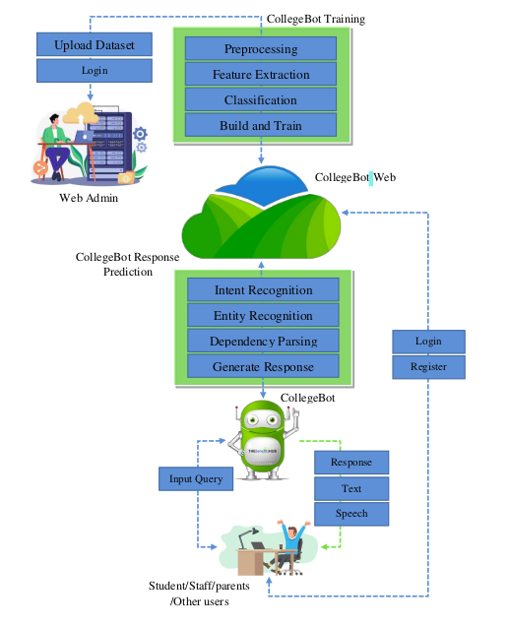
Architecture

Slide 11
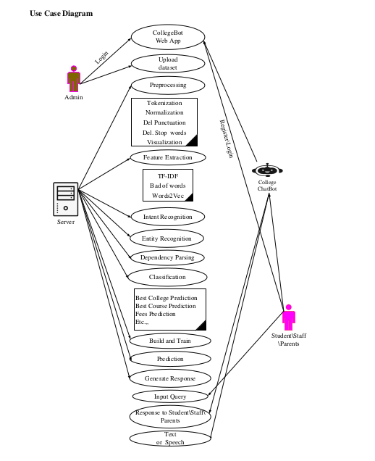
Design Phase

Slide 12
Modules
Admin Module: This module includes the functionality of collecting the dataset related to Cloud, pre-processing it using stemming, lemmatization, removal of stop words, and tokenization techniques.
Then, the feature extraction is done using two techniques – bag of words (BoW) and term frequency-inverse document frequency (TF-IDF). Finally, the NLP model is trained using the extracted features.

Slide 13
User Module: This module includes two types of users –Student/Staff/parents/Other users and system administrators. users can register and login to the system. They can input their queries in English, which will be analysed by the NLP model to predict the intent, recognize entities, and generate responses using dependency parsing

Slide 14
Chat module: that chat module contain the chat respond tab Natural Language Processing (NLP): NLP modules enable the chatbot to understand and interpret user input. They involve techniques like intent recognition, entity extraction, and sentiment analysis. Popular NLP frameworks include spaCy, NLTK, and Rasa. response module: that response module was contain the ai based chat-bot using the algorithm of natural language processing (nlp) that will use to produce the answer for the questions for the example if we type: hello how are you? that bot will response: I am good how about you like that that response module was design

Slide 15
Implementation Details
NLP Packages: The NLP packages used in the system can include NLTK, spaCy, and TextBlob. These packages can provide functionalities like tokenization, stemming, cinematization, removal of stop words, entity recognition, dependency parsing, and sentiment analysis.
MySQL Database: The MySQL database can be used to store the dataset, user information, and system logs. The dataset can be stored in a separate table, and the user information can be stored in a separate table with appropriate attributes. The system logs can be stored in a separate table to monitor the system's performance.

Slide 16

Flask Framework: The Flask framework can be used to develop the web application. It can provide functionalities like routing, request handling, session management, and userauthentication. chat-bot training: Cloud-Bot, being an AI-based Clouds' chatbot, requires extensive training in natural language processing (NLP) techniques. The following are the sub modules involved in training the

Slide 17
Ultimate findings of the project
User Satisfaction: Evaluate user satisfaction with the chatbot by collecting feedback and conducting user surveys. Measure factors like user engagement, perceived usefulness, and overall user experience
Response Generation: Evaluate the quality of generated responses by the chatbot. Assess whether the responses are relevant, coherent, and provide helpful information to users.
Efficiency and Scalability: Assess the performance of the chatbot in terms of response time, scalability, and system resource usage

Slide 18
Hardware base
Processors:
Intel® Core™ i5 processor 4300M at 2.60 GHz or 2.59 GHz (1 socket, 2 cores, 2 threads per core), 8 GB of DRAM
Disk space: 320 GB
Operating systems: Windows® 10, macOS*, and Linux*

Slide 19
Software specification
Server Side: Python 3.7.4(64-bit) or (32-bit)
Client Side: JQyerty HTML, CSS, Bootstrap
IDE: Flask 1.1.1
Back end: MySQL 5.
Server: Wampserver 2i
OS: Windows 10 64 –bit or Ubuntu 18.04 LTS “Bionic Beaver”
DL Packages : Pandas, SciKitLearn, NumPy

Slide 20
Conclusion
In conclusion, CloudBot, an AI-based Cloud Chatbot developed with Python Flask NLP Packages and MySQL, provides a solution for users to have access to Cloud information and solutions through an intuitive and interactive chat interface. The chatbot makes use of Natural Language Processing (NLP) techniques such as stemming, lemmatization, removal of stop words,

Slide 21
Future work
There are several future enhancements that can be made to "CloudBot: An AI based Cloud
Chatbot" developed with Python Flask NLP Packages and MySQL:
Multilingual support: Currently, the chatbot only supports queries in English. However, it can be enhanced to support multiple languages, making it accessible to users who speak different languages.
Image and video recognition: In addition to text-based queries, the chatbot can be enhanced to recognize and respond to queries containing images or videos related to Cloud.
Personalization: The chatbot can be enhanced to personalize responses based on the
user’s previous queries and preferences.

Slide 22
Possible Usage
Sales and marketing: Chat-bot can be used to engage with potential customers
Healthcare: Chat-bot can be used to assist patients with booking appointments, tracking their symptoms, and even provide guidance on treatments and medications.

Slide 23
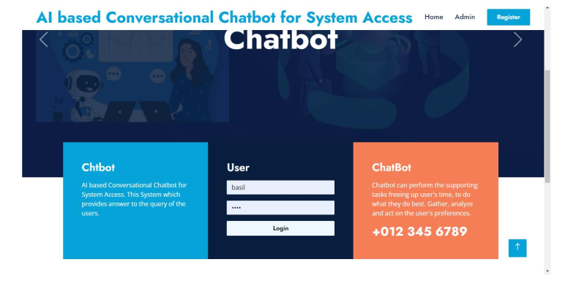
Screenshots

Slide 24
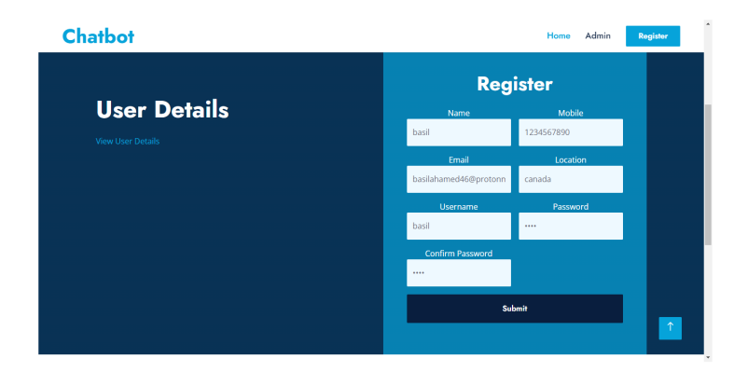
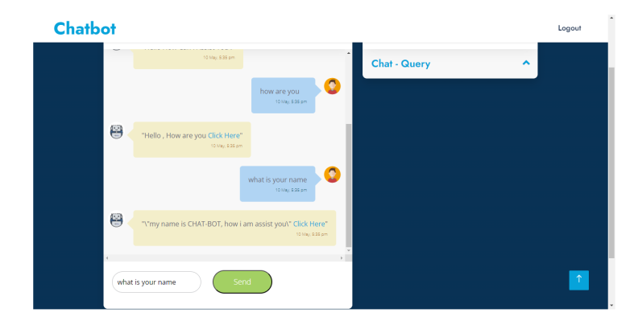

Slide 25
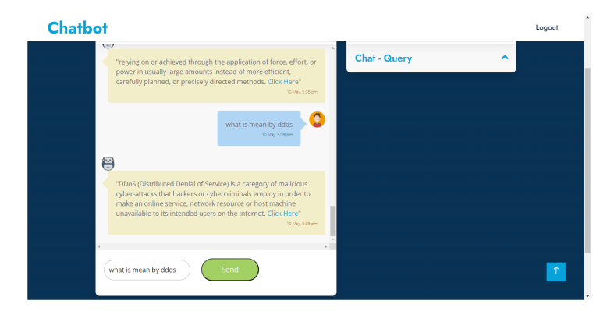
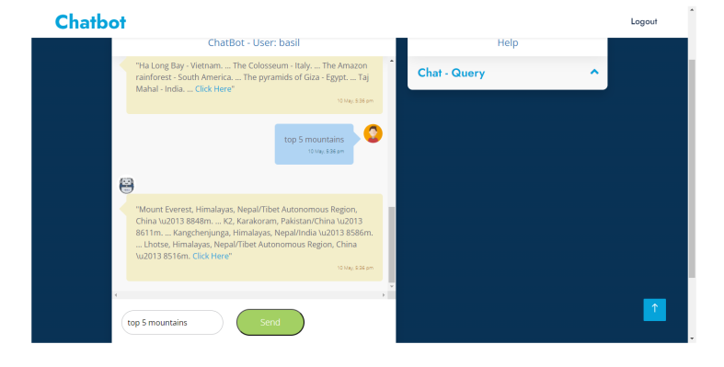

Slide 26
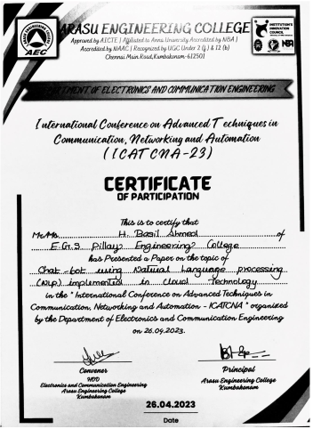
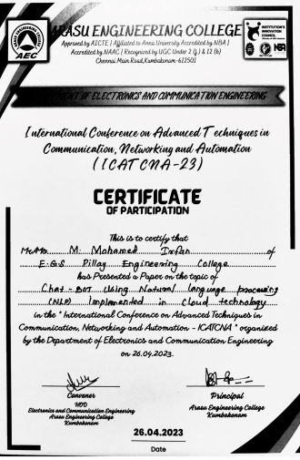
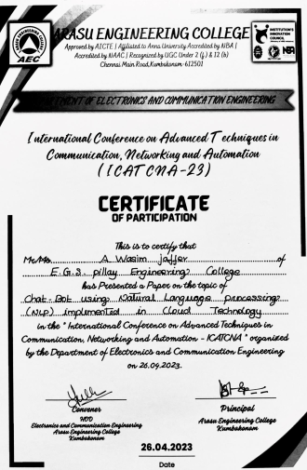
Conference attended with Paper Presentation

Slide 27
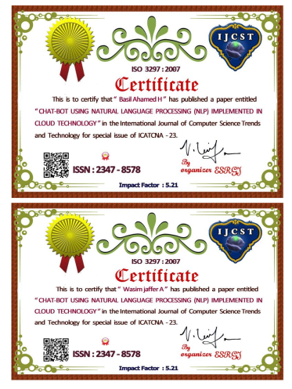
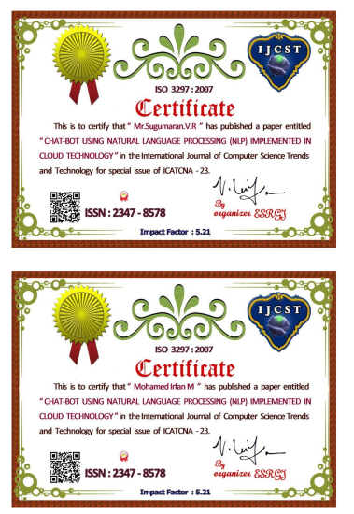
Paper submission to Journals certificate

Slide 28
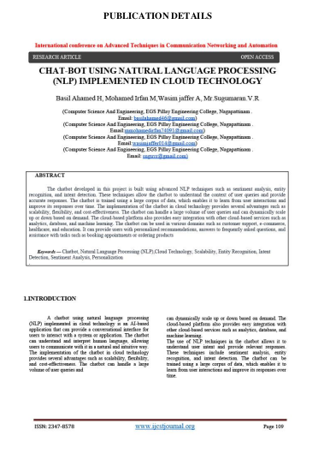
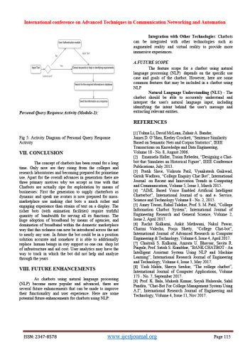
IJEST JOURNAL PUBLICATION

Slide 29


